Slide 1
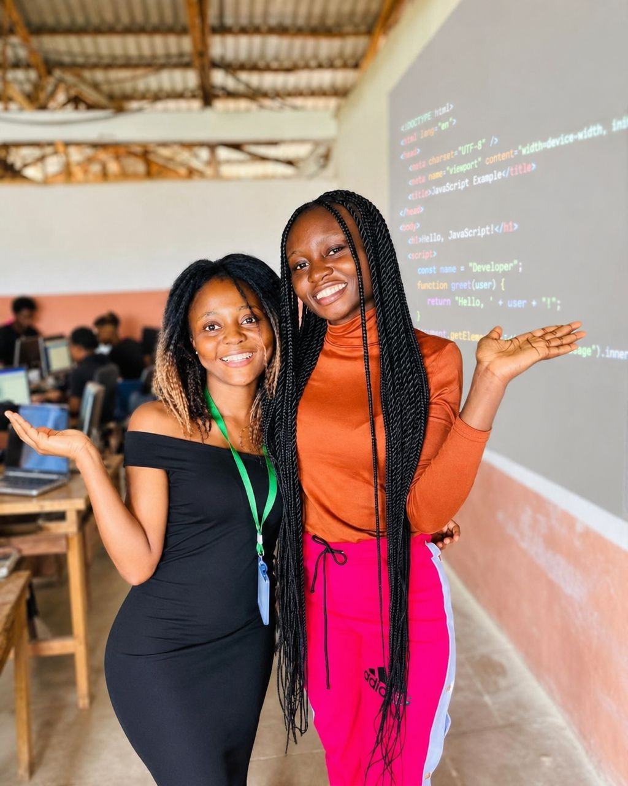

Creators,
Not Consumers
Sponsorship Opportunities
Putting technology in the hands of every child in Cameroon.
Giiyo Foundation · Reg. No. 00001551/ARDA/JO6/SAJPA/APPB · Douala, Cameroon · giiyotech.com

Slide 2
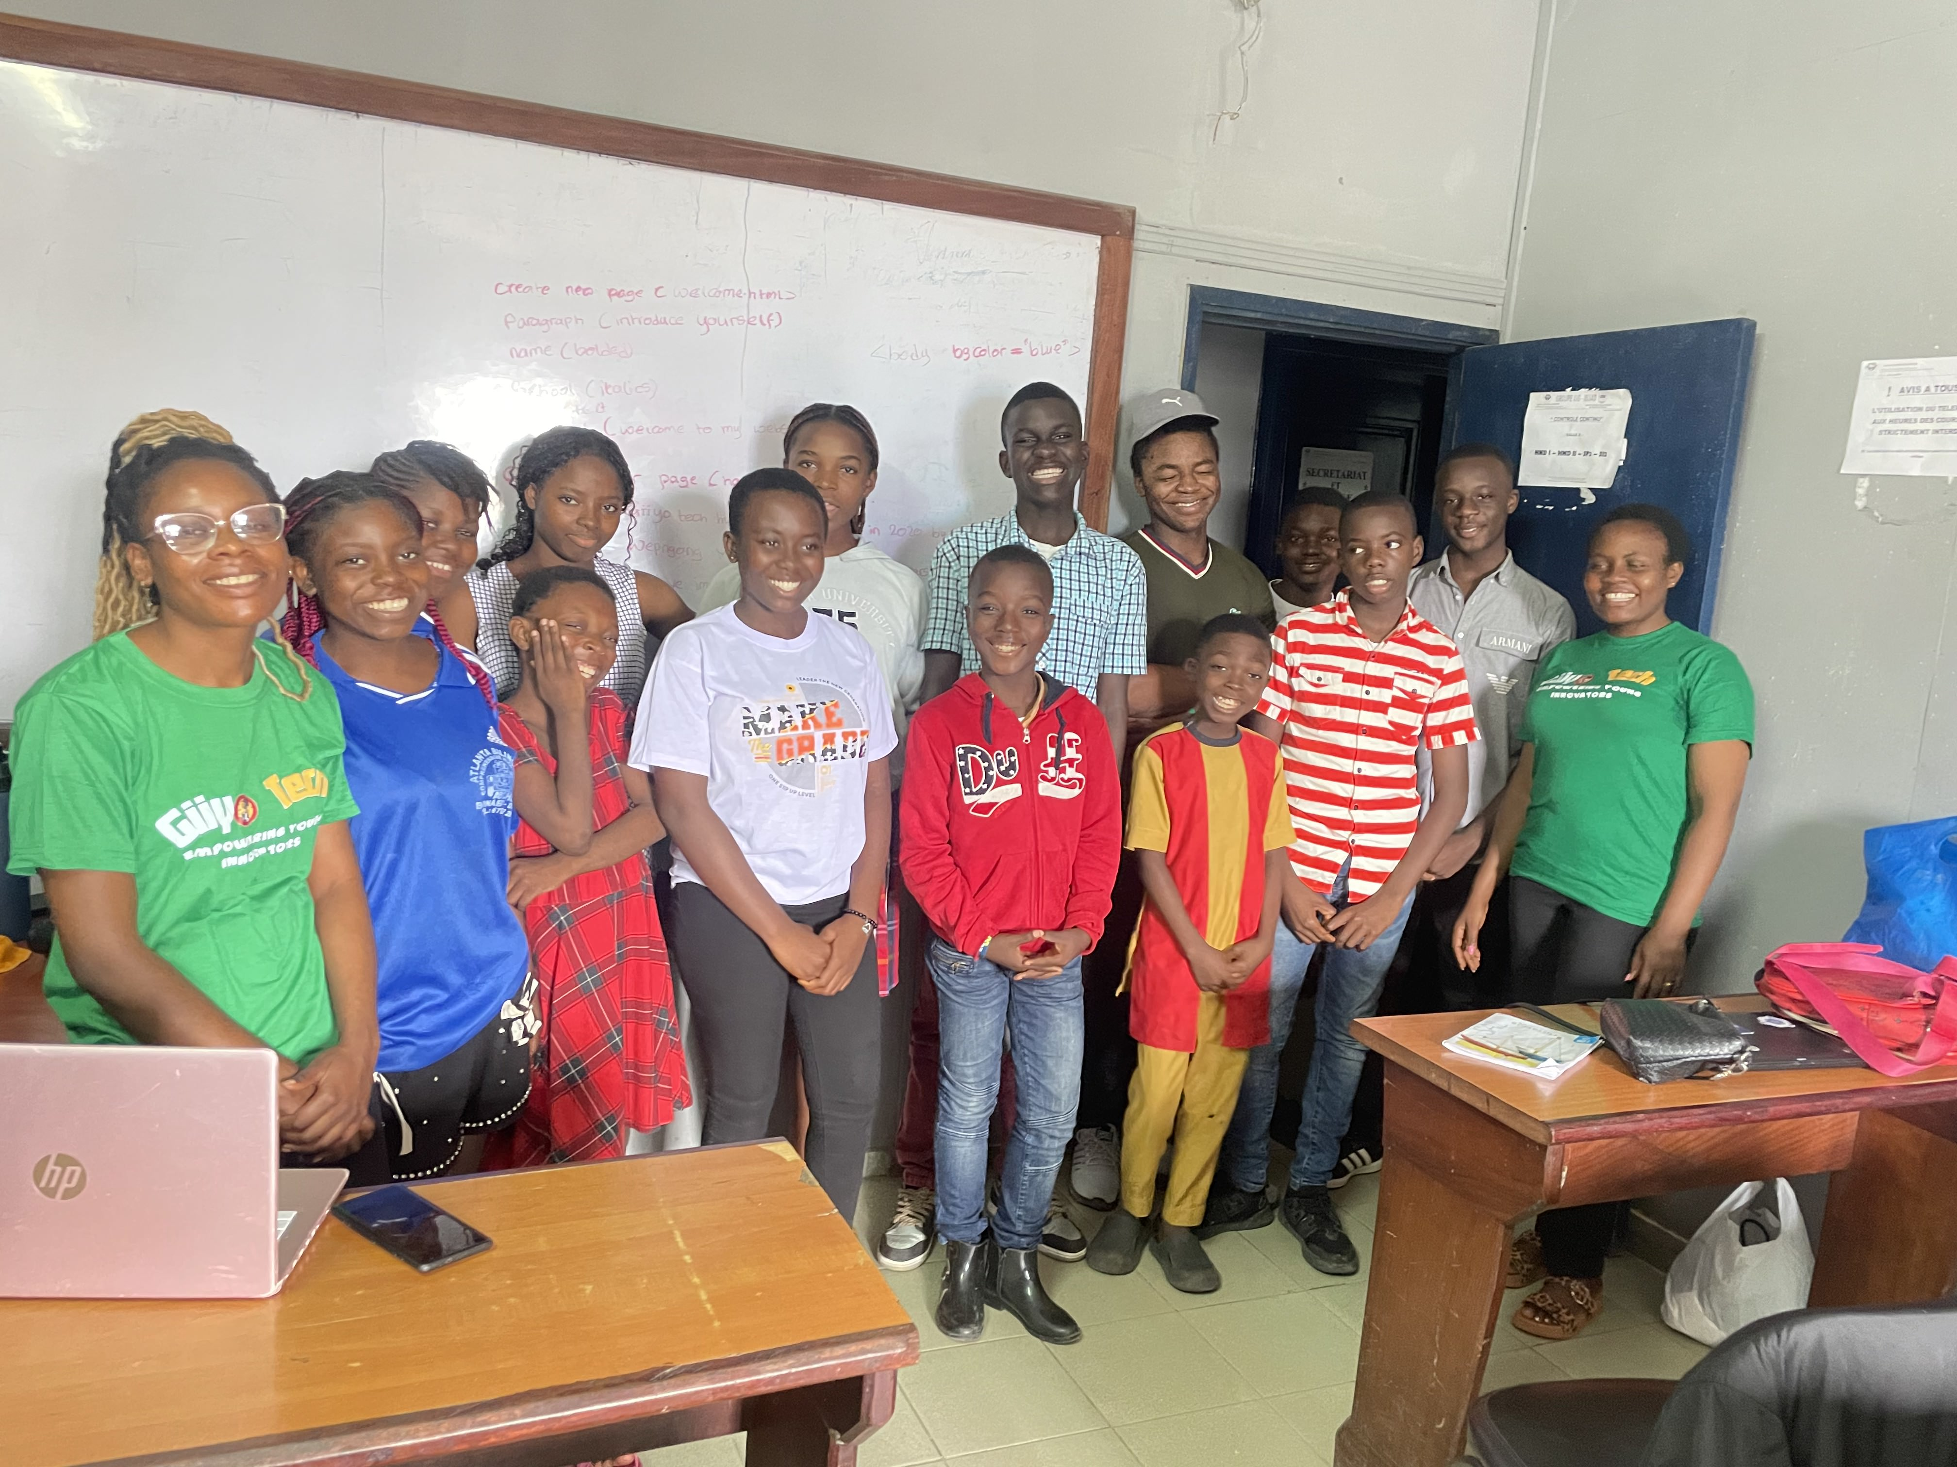
The Problem
In Cameroon, most children finish school without ever writing a line of code, building a website, or understanding how the technology around them works.
Many schools have no computers, no trained teachers, and no digital-skills curriculum.
As the world reorganises around software and AI, an entire generation risks being locked out — positioned as passive users of tools built elsewhere.
“The next person to solve Africa’s biggest problems is probably a 10-year-old who just needs a laptop and a chance.”
Giiyo Foundation · Reg. No. 00001551/ARDA/JO6/SAJPA/APPB · Douala, Cameroon · giiyotech.com

Slide 3
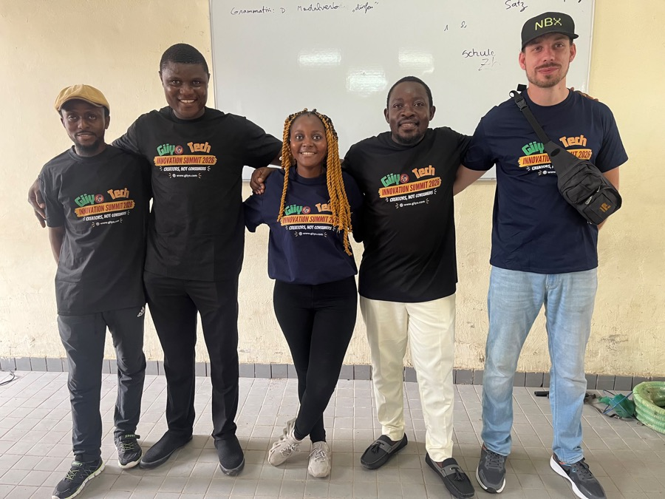
Who We Are
Giiyo Tech is an initiative of Giiyo Foundation, a nonprofit registered in Cameroon and headquartered in Douala.
“Giiyo” means “do yours” in Limbum. We turn young people aged 7 to 19 from consumers of technology into creators of it — through hands-on coding, AI, robotics, 3D design, and digital literacy, in English and French.
Founded in March 2024, we have grown from a single bootcamp of 11 students into a multi-program organisation reaching 500+ young people — entirely self-funded to date.
Giiyo Foundation · Reg. No. 00001551/ARDA/JO6/SAJPA/APPB · Douala, Cameroon · giiyotech.com

Slide 4
What We Do
Five hands-on programs that meet students where they are.
1
STEM Clubs in Schools
Weekly club sessions delivered inside partner schools across six tracks.
2
Holiday Bootcamps
Intensive school-break training in coding, AI, design, robotics, and 3D printing.
3
Innovation Summit
Our flagship showcase where students present the technology they built.
4
Digital Literacy 101
Online safety, scams, privacy, and digital footprints for students and communities.
5
Emerging Technologies
AI, 3D printing, and Web3 — preparing students for the industries reshaping work.
Giiyo Foundation · Reg. No. 00001551/ARDA/JO6/SAJPA/APPB · Douala, Cameroon · giiyotech.com

Slide 5
Our Impact So Far
Every student reached without a single grant — so far.
500+
5
5
2
Students reached
Core programs
Cities in Cameroon
National press features
Sources: giiyotech.com public impact data and independent press coverage (Mimi Mefo Info, 2024 & 2025).
Giiyo Foundation · Reg. No. 00001551/ARDA/JO6/SAJPA/APPB · Douala, Cameroon · giiyotech.com

Slide 6

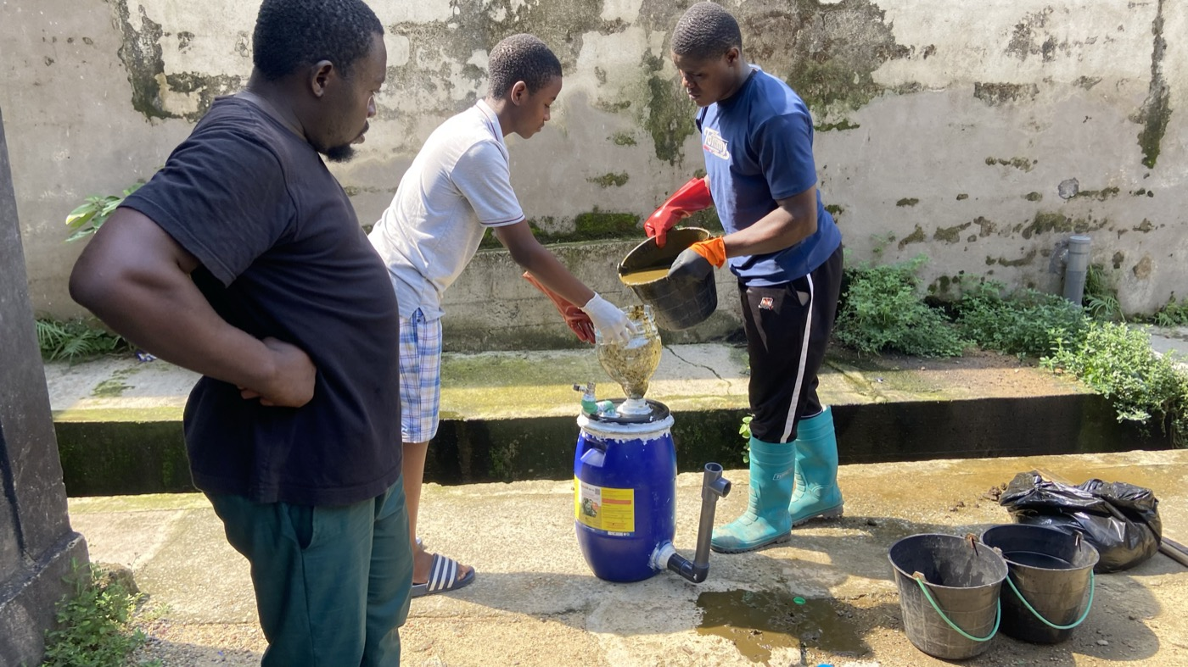
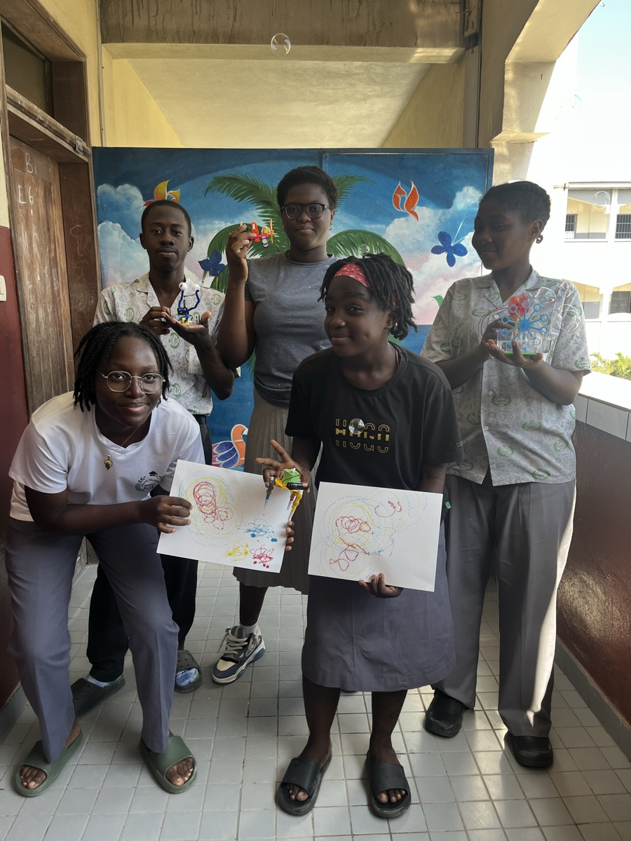
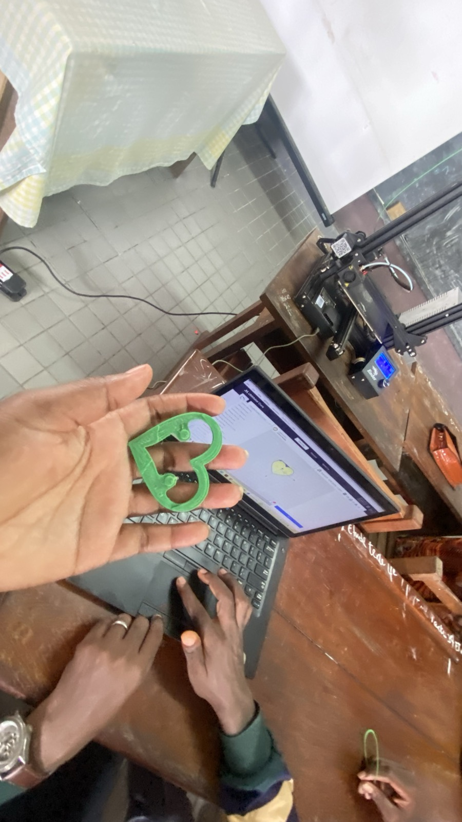
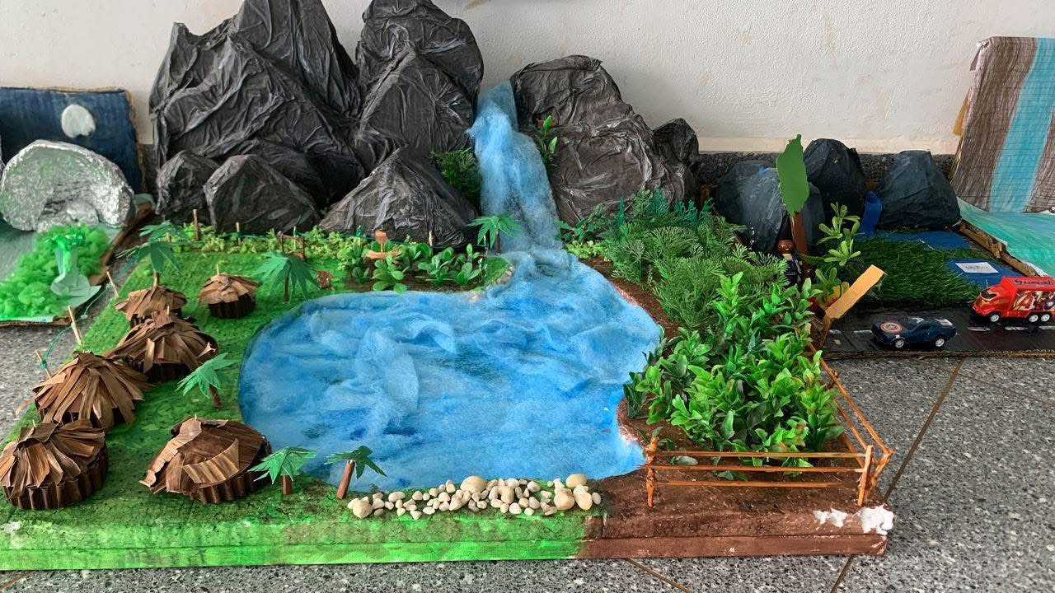
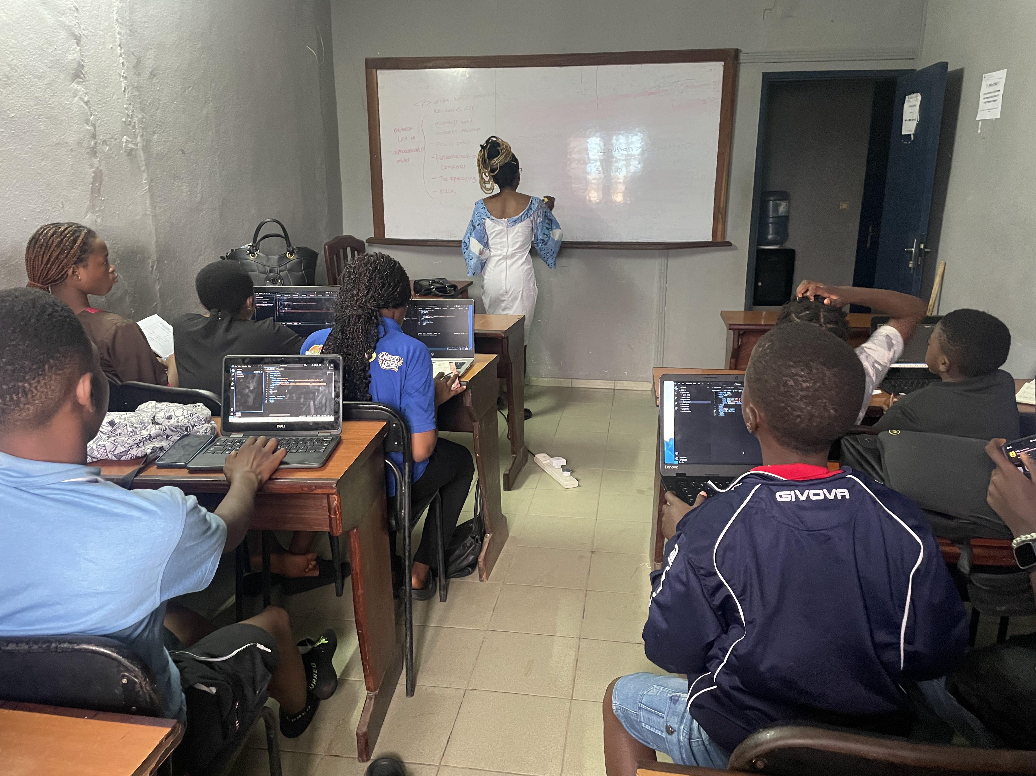
What Our Students Build
Every project starts with a real problem a student observed and wrote down.
Bosangi
Biogas System
Robots
Plastic bottles → paving stones
Organic waste → clean cooking gas
Built from circuits & motors
3D Printing
Topographical Models
Problem-Solving Apps
Designed and printed by students
Local materials as research tools
Attendance, medicine, market prices
Giiyo Foundation · Reg. No. 00001551/ARDA/JO6/SAJPA/APPB · Douala, Cameroon · giiyotech.com

Slide 7
Why It Works
Problem-first, always
Students don’t copy tutorials. They document a real problem in their community, then learn the technology to solve it. We keep their original written statements on file, word for word.
From code to community
Projects tackle what students actually live with: power cuts, market prices, plastic waste, language loss, school administration.
Shown in public
Every graduate presents a working project to parents, judges, and community members at the Innovation Summit.
Giiyo Foundation · Reg. No. 00001551/ARDA/JO6/SAJPA/APPB · Douala, Cameroon · giiyotech.com

Slide 8
What Your Support Buys
Funding changes one specific thing: it lets us serve the students who cannot pay.
€20
€50
€150
€300
€1000
Learning materials for one STEM Club student
Supports one community workshop participant
Helps deliver a full STEM Club session
Sponsors a learner through a technology bootcamp
Supports an entire Innovation Summit
Sponsors can also fund specific needs directly — laptops, robotics kits, 3D printers, and cohort places.
Giiyo Foundation · Reg. No. 00001551/ARDA/JO6/SAJPA/APPB · Douala, Cameroon · giiyotech.com

Slide 9
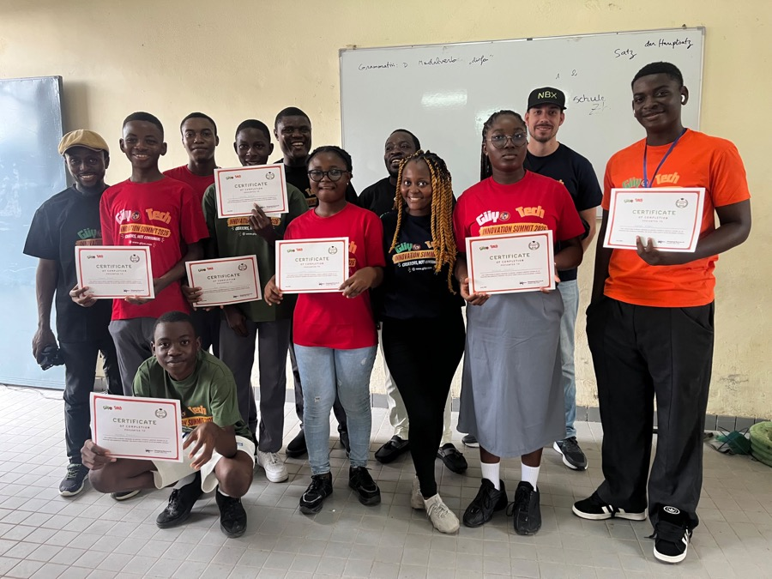
Build Africa’s Future
With Us
Your support puts the next idea in a student’s hands. Partner with us, sponsor a program, or fund equipment that serves cohort after cohort.
hello@giiyotech.com
+237 674 028 515 · WhatsApp +237 670 199 687
giiyotech.com · Douala, Cameroon
Giiyo Foundation · Reg. No. 00001551/ARDA/JO6/SAJPA/APPB · Douala, Cameroon · giiyotech.com

